Slide 1
Model Architectures

Slide 2
Astroinformatics of galaxies and quasars: a new general method for photometric redshifts estimation

Slide 3
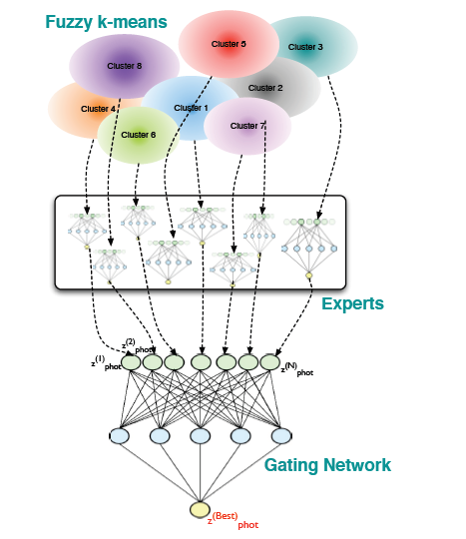
Weak-Gated Experts
Fuzzy K-Means
Experts
Neural Network
Output

Slide 4
Optical Photometry
4D Clustering
Optical Photometry:
clustered 4D feature space ->
train single expert on each cluster ->
gating network combines distinct outputs
Train Expert on Each Cluster
Train Expert on Each Cluster
Train Expert on Each Cluster
Gated Network
Combines
Distinct Output

Slide 5
Redshift of Quasars with Optical Photometry
4D Clustering
redshifts of quasars with optical photometry:
4D clustering -> experts trained on 8D features space generated
by 4 colors ->
rest similar to first experiment
(.15 for fuzzy clustering)
Experts Trained on 8D feature space
Experts Trained on 8D feature space
Experts Trained on 8D feature space
Gated Network
Combines
Distinct Output

Slide 6
Others
Redshift and UV experiments seem to be similar as others except 6 uncertainties from 5 SDSS optical filters 2 UV filters

Slide 7
AstroCLIP: Cross-Modal Pre-Training for Astronomical Foundation Models

Slide 8
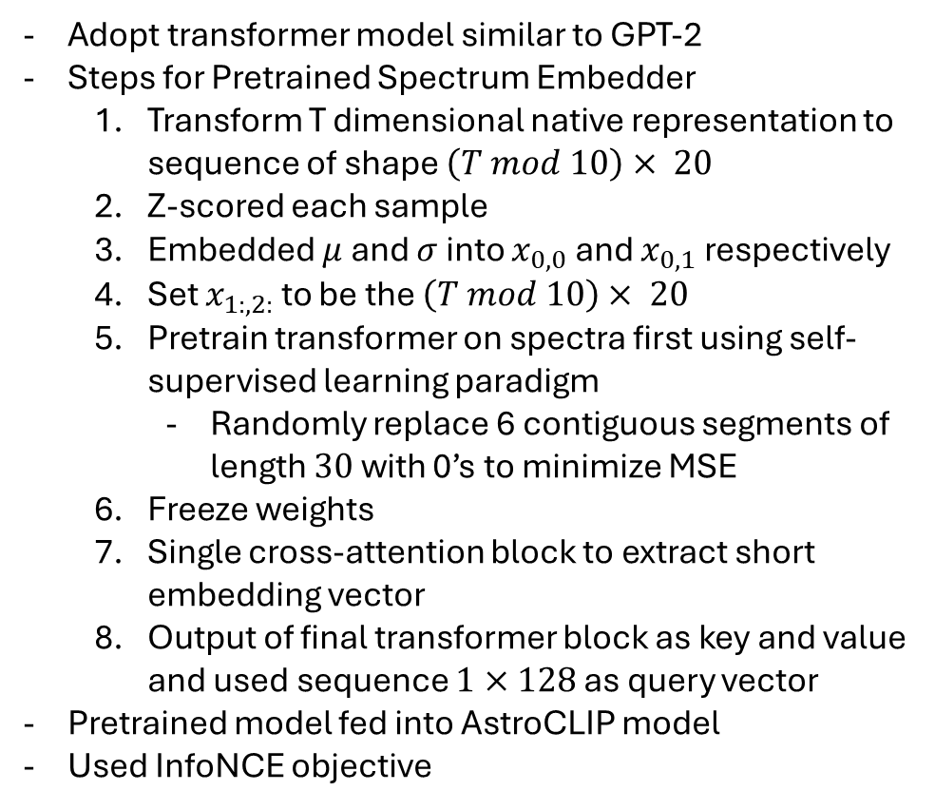
Pretrained Spectrum Embedder Model
Pretrained Spectrum Embedder
AstroCLIP Model

Slide 9
Pretrained Image Embedder Model
Pretrained Image Embedder
Steps for Pretrained Spectrum Embedder
1. used pretrained image encoder from Stein et al
2. pretrained in self-supervised regime
Pretrained model fed into AstroCLIP model
Used InfoNCE objective
AstroCLIP Model

Slide 10
Classification of Astronomical Bodies by Efficient Layer Fine-Tuning of Deep Neural Networks

Slide 11
Transfer Learning
Preprocess Data to 512 x 512 x 3
Transfer Models
Resnet50
Xception
VGG16
EfficientNet B2
DenseNet121
NasNetMobile
MobileNetV2
Softmax Output with 3 classes

Slide 12
Classifying Radio Galaxies with Convolutional Neural Networks

Slide 13
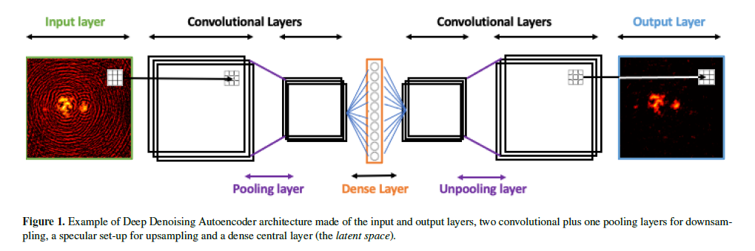
Deep Denoising Autoencoder Visualization

Slide 14
Deep Denoising Autoencoder Training
Initial Setup
network is setup reading parameters
training images stored from FITS files
emissivity set to floor value of 10⁻⁸
Preprocessing
normalise results
divide image into tiles
serialize tiles
mini batches
The Network is Saved
Deep Denoising Architecture

Slide 15
Deep Learning Approach to Photometric Redshift Estimation

Slide 16
Decision Tree Regressor
decision tree regressor
5 bandpass filters (u, g, r, i, z) as features
each leaf predicts average redshift

Slide 17
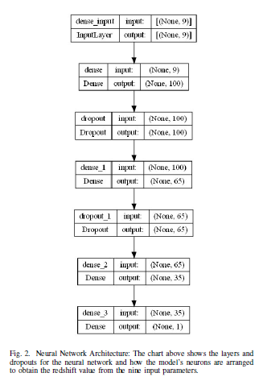
Fully Connected Neural Network
9 inputs
magnitudes of band passes and differences
output shape of 100
RELU activation function
dropout rate of 0.2
minimized used MSE

Slide 18
Deep learning based detection of cosmological diffuse radio sources

Slide 19
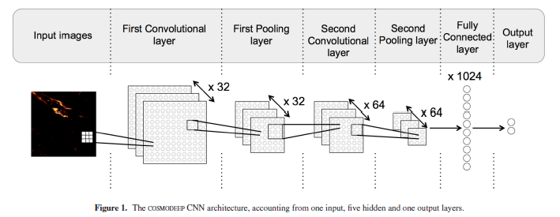
Cosmodeep Convolutional Neural Network
Workflow
Image Generation
Tiling
Labelling
Feeding into Model

